Slide 1

Checkmate Breast Cancer
DESKTOP APPLICATION
Menna allah anwer ali 42015113
Amira ahmed hafez 42015141
Nada alaa mohammed 42014129
Sara mohamed Abdelaziz 42015049
Mohamed essam omar 42015091

Slide 2
Problem definition
Breast cancer seemed to be an unsolved problem for much of the last century. An unchanging death rate from 1930 to 1960 and still increasing.
In the past few years doctor’s diagnosis for human’s Breast Cancer have been leading a lot of them stray and causing massive casualties.
Some doctors do not examine and make the wrong conclusion, leading to false diagnosis and delayed detection of the tumor, which leads to loss of life of some cases.
The diagnosis may be low-accurecy

Slide 3
Solution
the primary target of this project is to eliminate this problem by using technology to make a very precise and safe diagnosis for different types of breast cancer by making a desktop application that takes numerical data from the blood analysis, sample, mammography mass and Fine Needle Aspirate and entering the data into the program to identify if there is a cancer or not and if the cancer is benign or malignant.
This project will help doctors in the speed of diagnosis and high accuracy and thus the speed of treatment and this is what the cancer patient needs. And rapid identification if this tumor is malignant or benign.

Slide 4
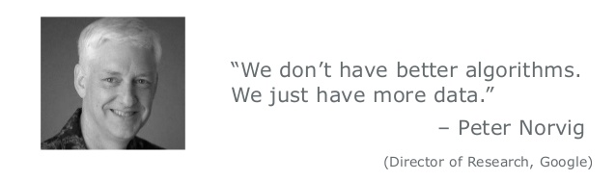
Machine Learning

Slide 5
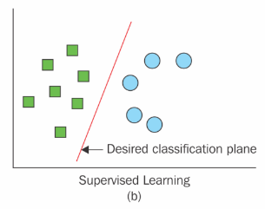
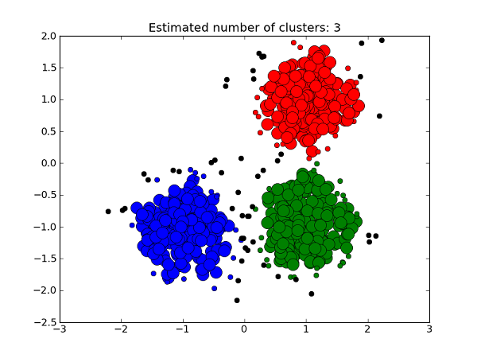
Learning Algorithm

Slide 6
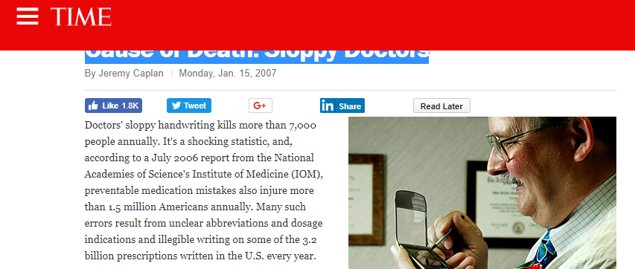
Classification

Slide 7
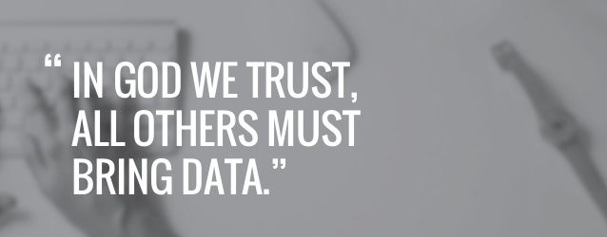

Slide 8
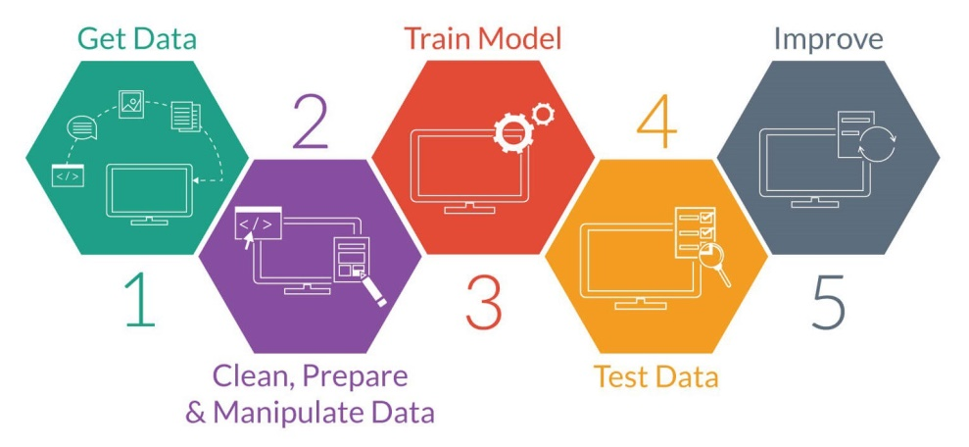
Machine Learning Process
“A baby learns to crawl, walk and then run. We are in the crawling stage when it comes to applying machine learning.”
-Dave Waters:

Slide 9
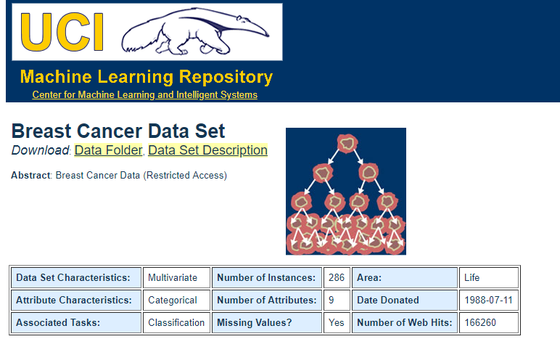
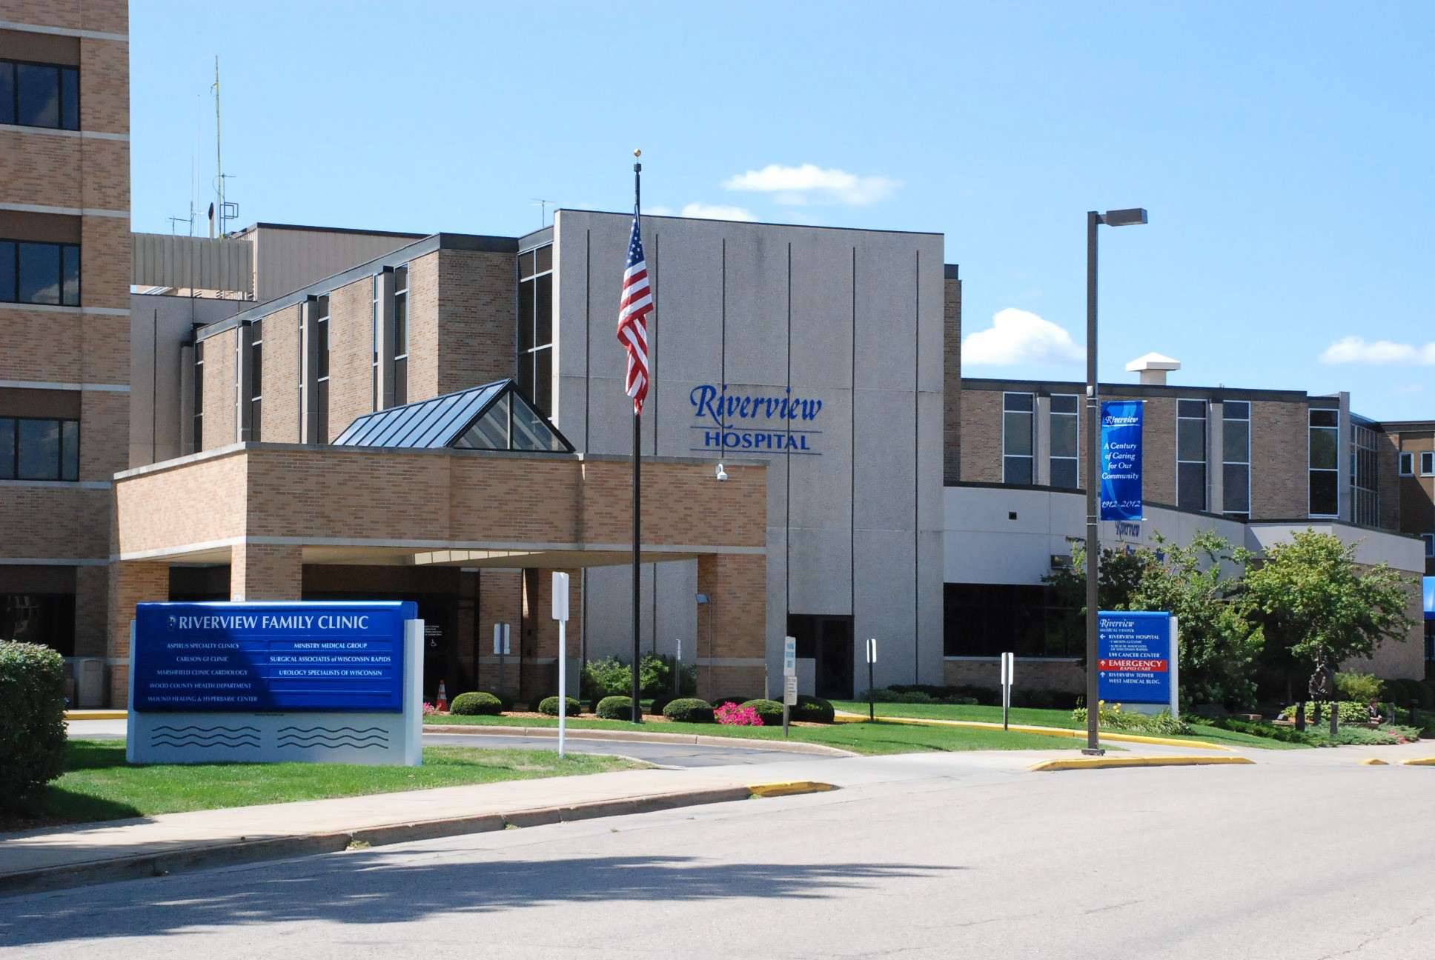

Slide 10


Slide 11
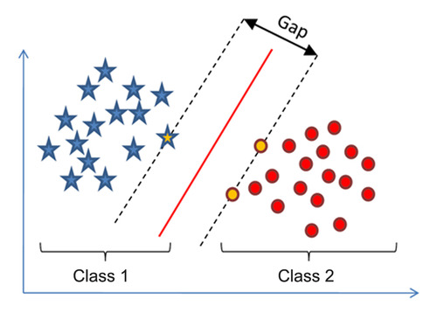
SVM

Slide 12
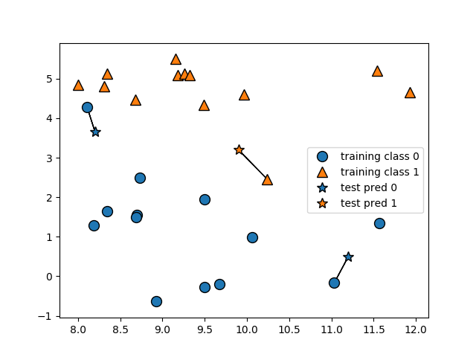
KNN

Slide 13
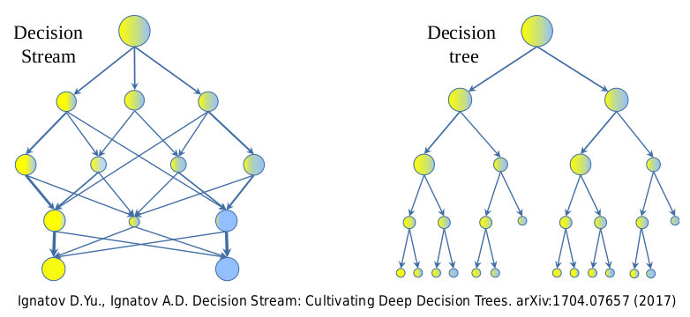
Tree

Slide 14
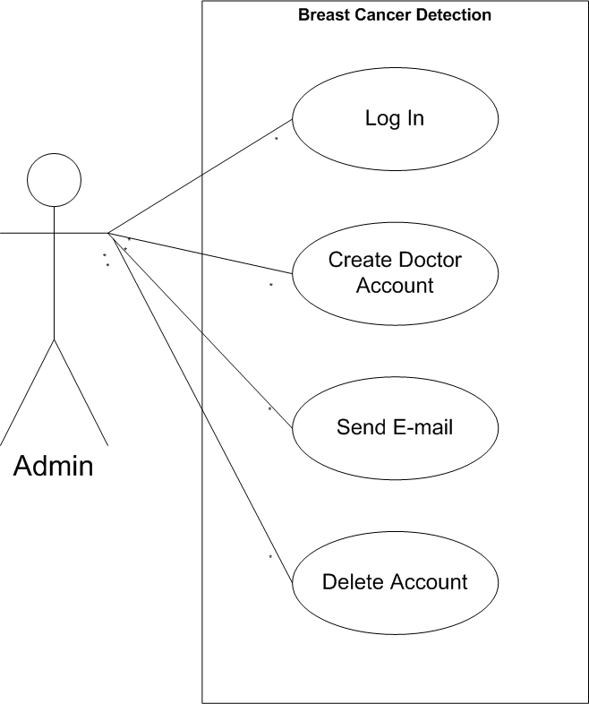
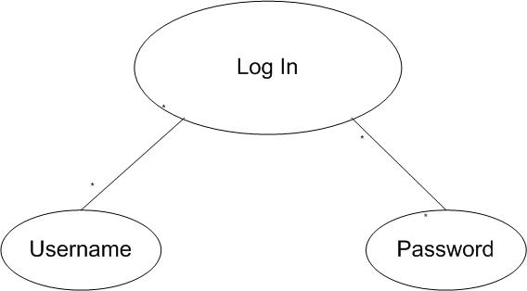
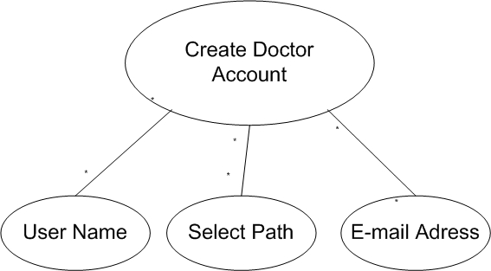
Analysis(use case)

Slide 15
Use case scenario
System | Checkmate Breast Cancer Application
Use-case | Login
Actor | Admin
Description | A page consists of a user name and password of the admin
Stimulus | Admin enter the user name and password
Response | Open the private registration page of the doctor
System | Checkmate Breast Cancer Application
Use-case | Create Account
Actor | Admin
Description | It consists of 2 part , the first is creat account doctor And the seconde list of accounts doctor.
Stimulus | The admin entre the name, password , e-mail, type of path doctor.
Response | The account is send to the doctor

Slide 16
Use case scenario
System | Checkmate Breast Cancer Application
Use-case | Send Email
Actor | Admin
Description | Admin send the account for the doctor
Stimulus | The doctor receiving the account
Response | Login to the program and deal with the program
System | Checkmate Breast Cancer Application
Use-case | Delete Account
Actor | Admin
Description | Admin can delete the doctor account .
Stimulus | Admin select the account who wants to delete it
Response | delete the account

Slide 17
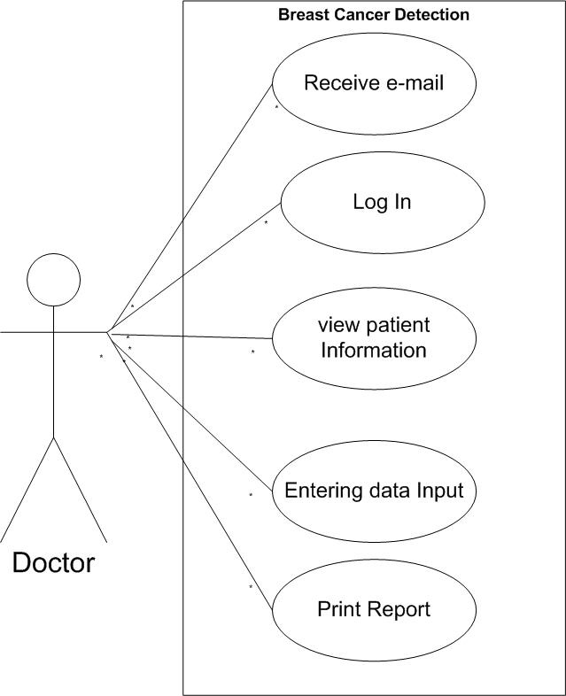
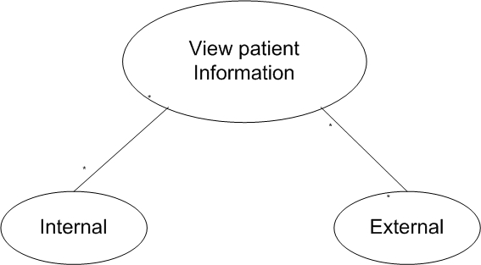
Analysis(use case)

Slide 18
Use case scenario
System | Checkmate Breast Cancer Application
Use-case | Receive e-mail
Actor | Doctor
Description | The doctor receive e-mail from admin and log in through him
Stimulus | Receive e-mail
Response | Log in to the application
System | Checkmate Breast Cancer Application
Use-case | Login
Actor | Doctor
Description | The doctor write the username and password to log in to application
Stimulus | enter the name and password
Response | It opens a pateint information window

Slide 19
Use case scenario
System | Checkmate Breast Cancer Application
Use-case | View patient information
Actor | Doctor
Description | A page divided by two parts of the first part, Enternal, and the second part is External
Stimulus | The first part enter the SSN patient to viw patient history , and second page create new patiant.
Response | Its open history of patient window.
System | Checkmate Breast Cancer Application
Use-case | Entering data Information
Actor | Doctor
Description | The doctor entering the data information of patient (sample, mammography, FNA, blood analysis)
Stimulus | The doctor inserts the numbers from the mammography or sample or FNA or blood analysis.
Response | determined whether it is benign or malignant

Slide 20
Use case scenario
System | Checkmate Breast Cancer Application
Use-case | Print Report
Actor | Doctor
Description | Written in which patient data and explanation of the condition of disease and final diagnosis
Stimulus | After you write the data by clicking Print Report
Response | The report is print

Slide 21
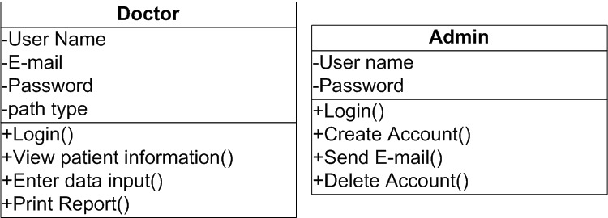
UML

Slide 22
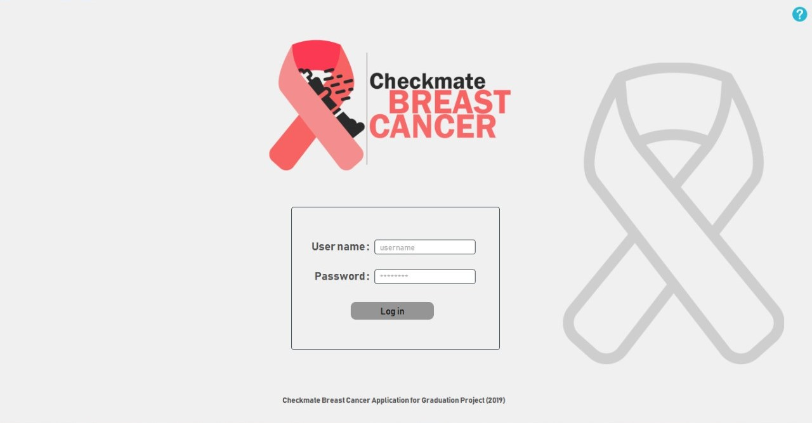
Application description
The login window for doctor or admin

Slide 23
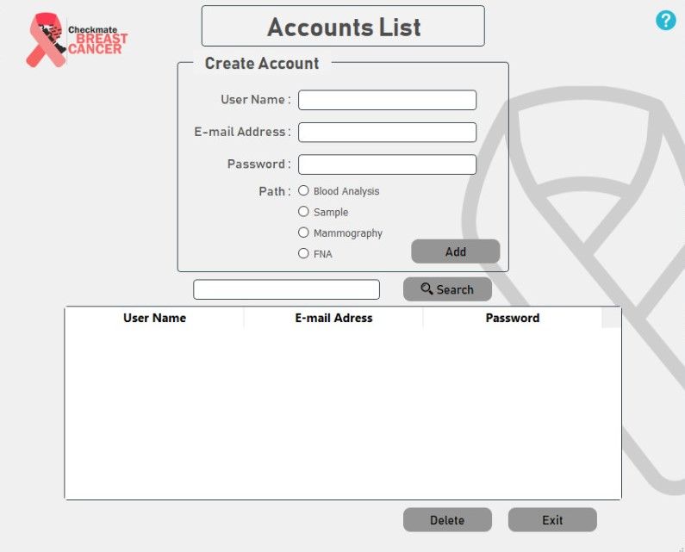
Application description
The Admin page to create account doctor and view accounts list.

Slide 24
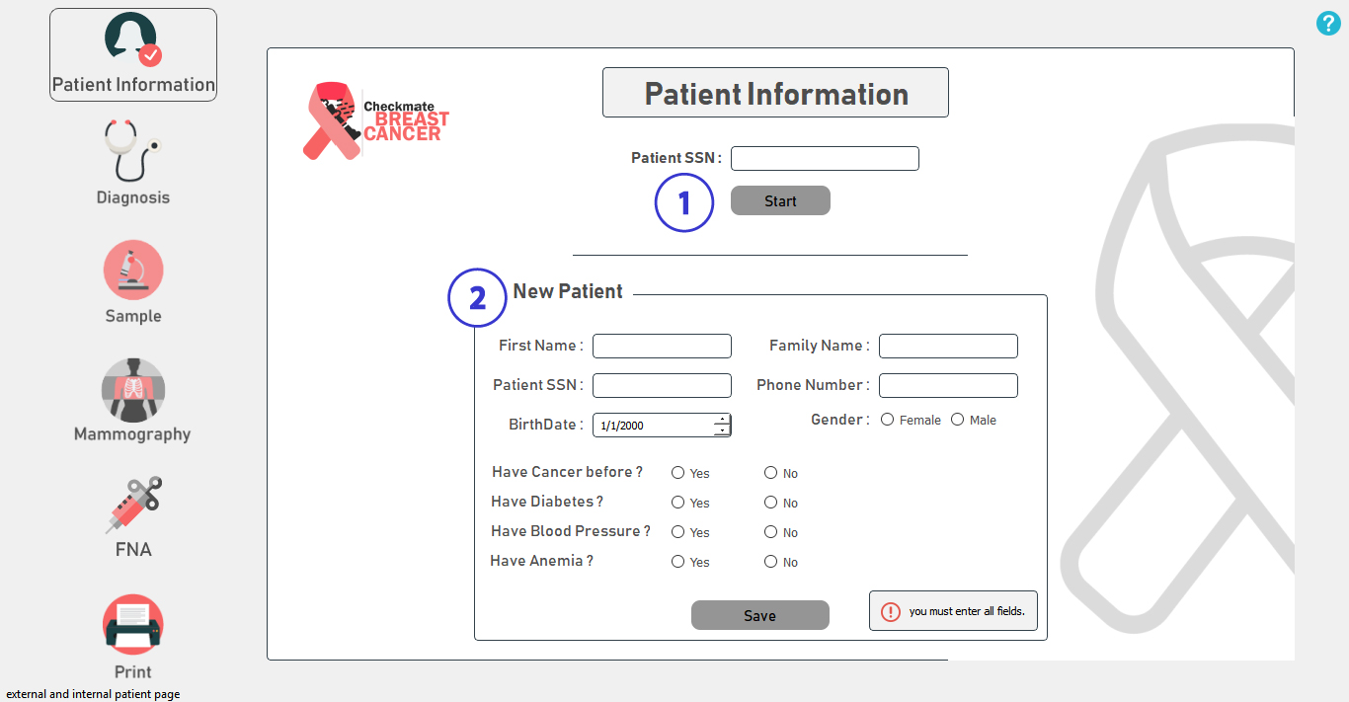
Application description
The Doctor Enter and View Patient History By patient SSN.
If the Patient is new, the Doctor will enter his information data to the application Database.ana save it.

Slide 25
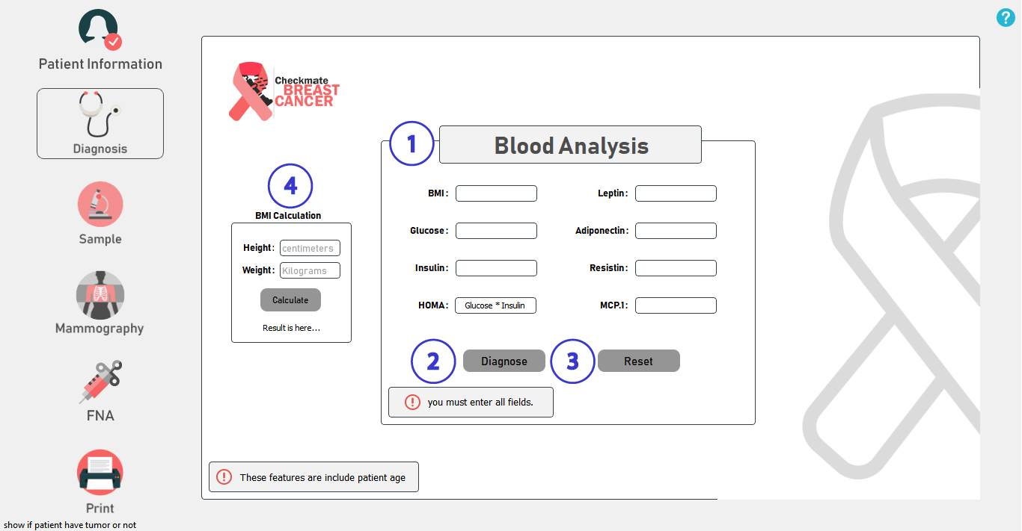
Application description
Blood Analysis determine patient have tumor or not
calculate the body mass by patient height and weight
If you Diagnose the result will appear to you
reset button will clear all data that you are entered.

Slide 26
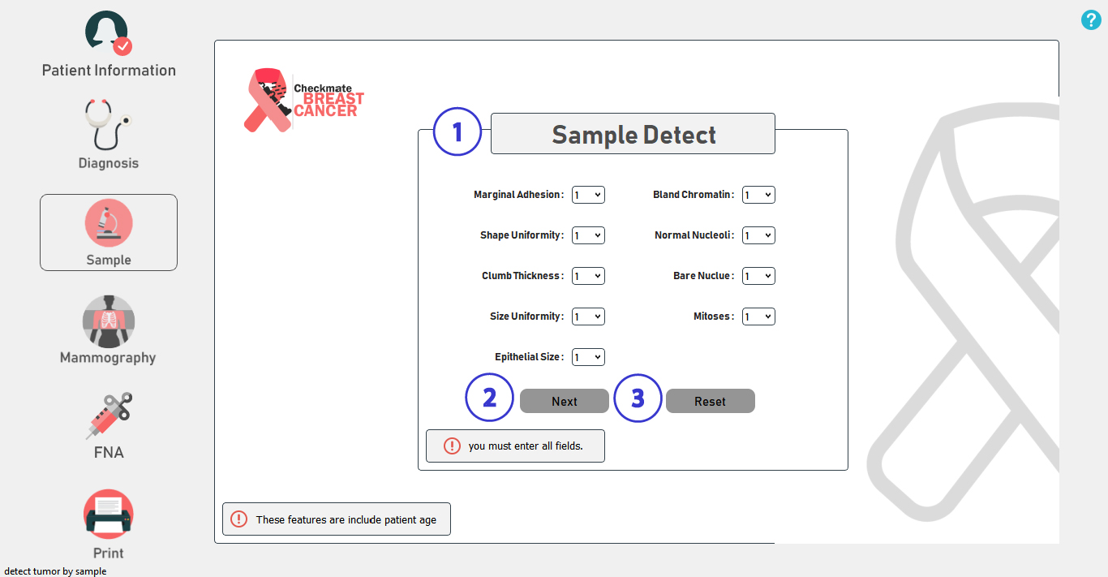
Application description
detect tumor if benign or malignant
When you click next you will go to the tumor recerrence window
Reset Button will clear all data that you are entered.

Slide 27
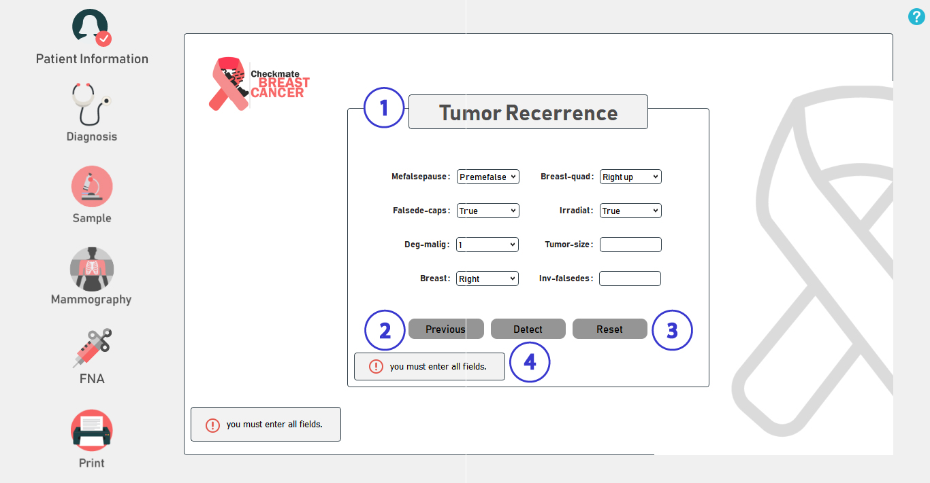
Application description
These features have been provided by using of the data techniques for increasing diagnosis and predicting it
If you press previous you will go back to the sample window
Reset Button will clear all data that you are entered
Detect Button will give you the Recurrence of Tumor Recurrence

Slide 28
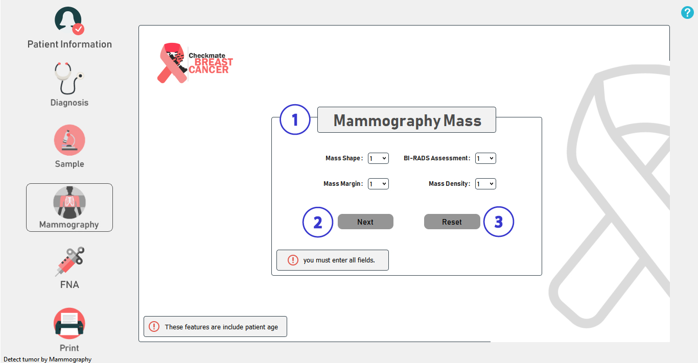
Application description
detect tumor if benign or malignant
When you click next you will go to the tumor recerrence window
reset button will clear all data that you are entered.

Slide 29
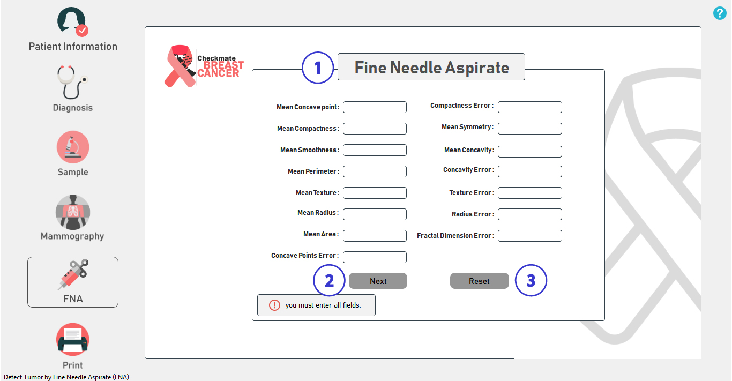
Application description
detect tumor if benign or malignant
When you click next you will go to the tumor recerrence window
reset button will clear all data that you are entered.

Slide 30
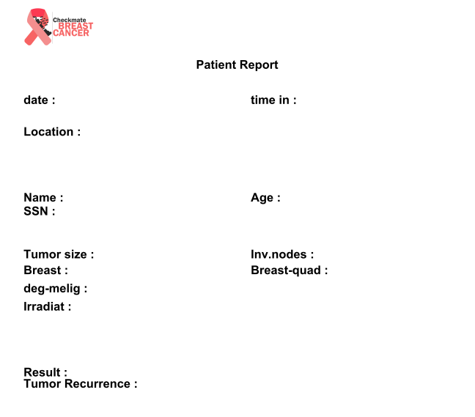
Report

